Slide 1
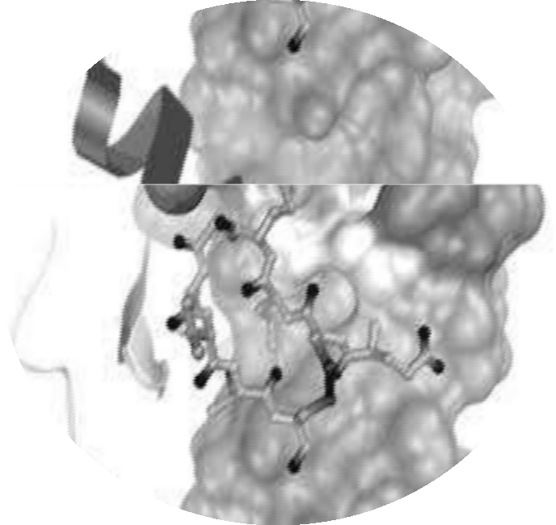
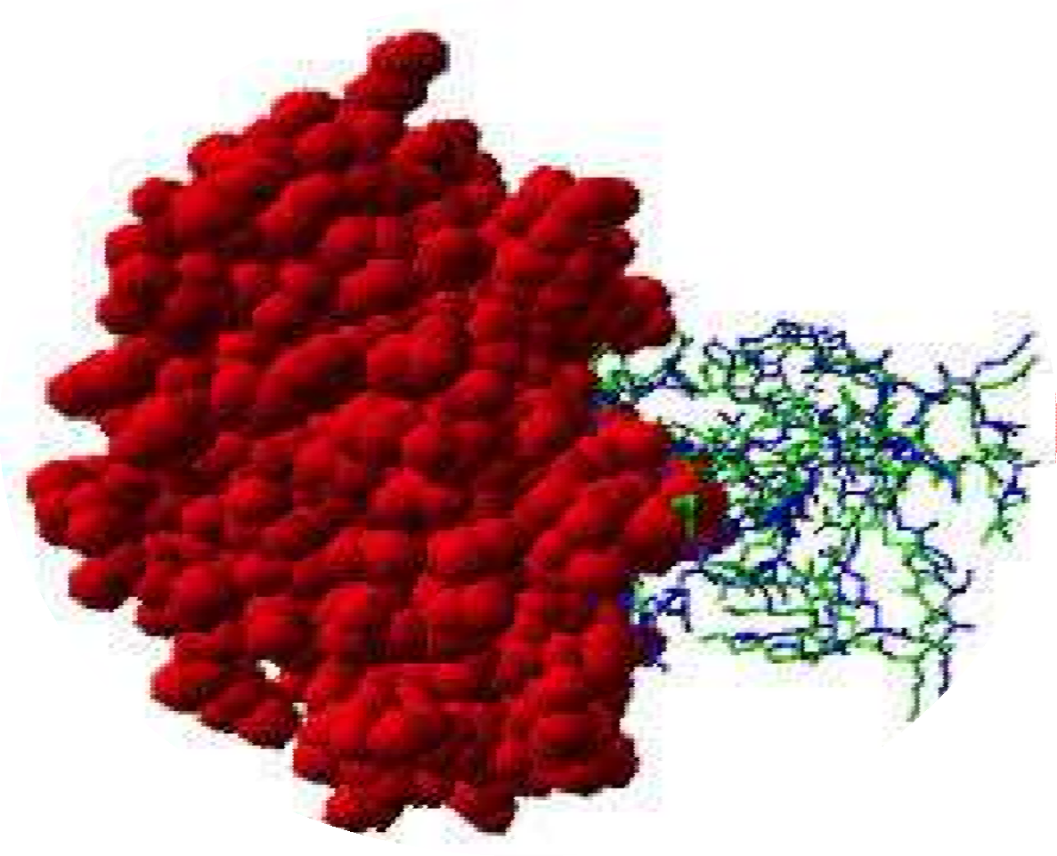
MOLECULAR DOCKING

Slide 2
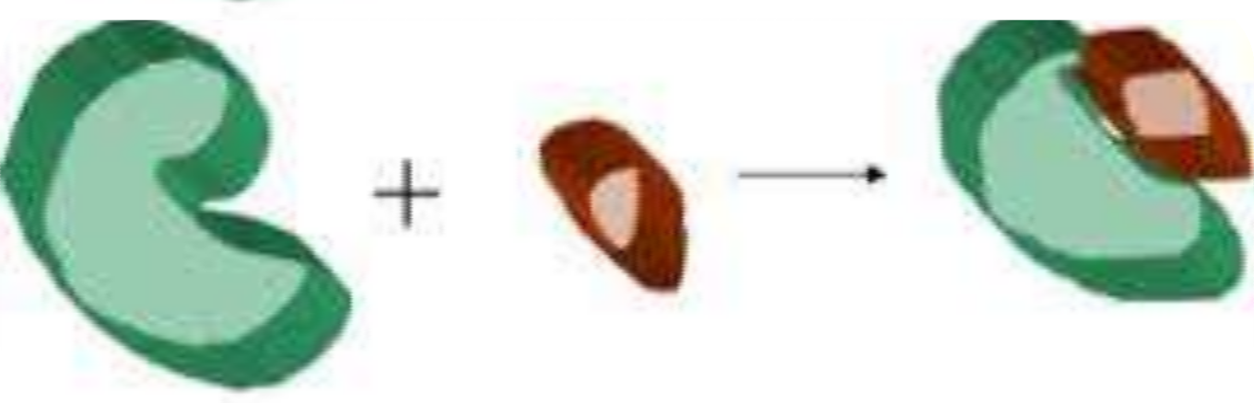
INTRODUCTION
Docking is an attempt to find the best matching between two molecules.
A more serious definition….
Docking is a method which predicts the preferred orientation of one ligand when
bound in an active site to form a stable complex.
Docking of small molecule ligand (brown) with a protein receptor (green) to produce
a complex.

Slide 3
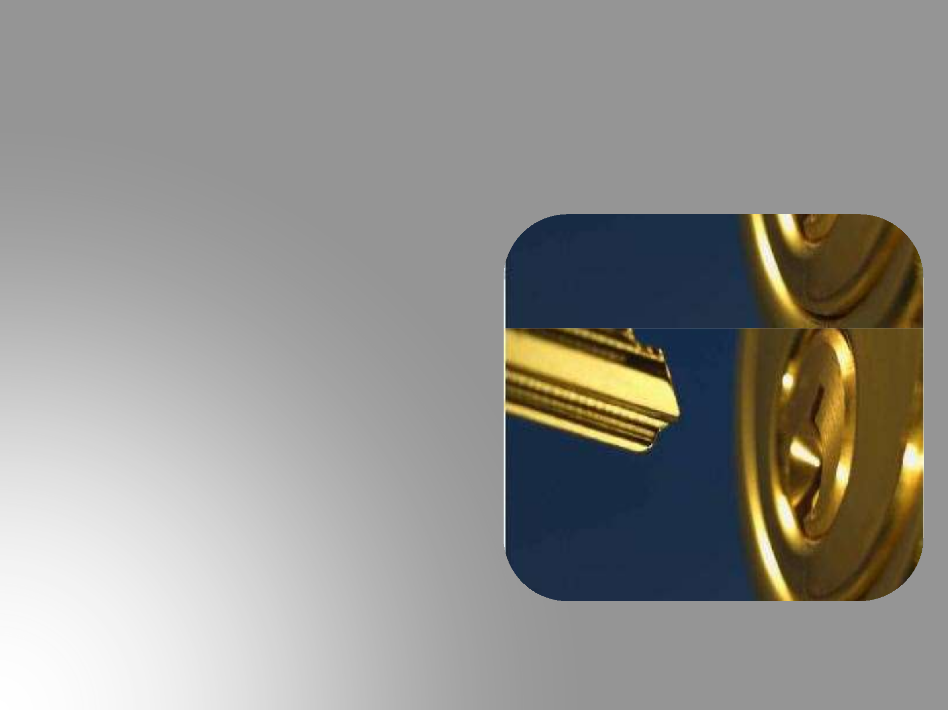
LOCK AND KEY
Finding the correct relative orientation of
the “key” which will open up the “lock”.
On the surface of the lock is the key
hole…
In which direction to turn the key after it
is inserted …

Slide 4

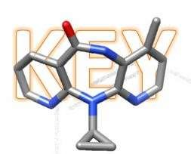
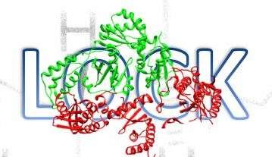
The protein can be thought of as the “lock” and the ligand can be thought of as a “key”.
NVP: Nevirapine
Crystallographic structure of HIV-1 reverse
transcriptase:
green coloured P51 subunit & red coloured P66 subunit

Slide 5
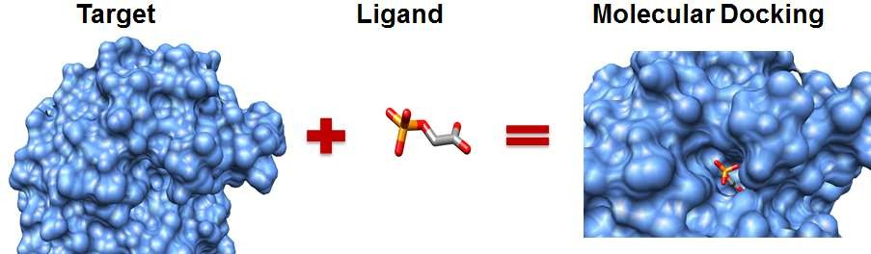
MOLECULAR DOCKING
Aim:
To achieve an optimized conformation for both receptor and ligand & the relative orientation between protein and ligand such that the free energy of the overall system is minimized
Successful docking methods search high-dimensional spaces effectively and use a scoring function that correctly ranks candidate dockings.

Slide 6
IMPORTANCE
Molecular Docking
Prediction of the binding affinity (Scoring Function)
Identification of the
ligand’s correct binding
geometry (pose) in the binding
site (Binding Mode)
Rational Design Of Drugs

Slide 7
Types of docking
Rigid Docking (Lock and Key)
In rigid docking, the internal geometry of both the receptor
and ligand are treated as rigid.
Flexible Docking (Induced fit)
An enumeration on the rotations of one of the molecules (usually smaller one) is performed. Every rotation the energy is calculated; later the most optimum pose is selected.

Slide 8
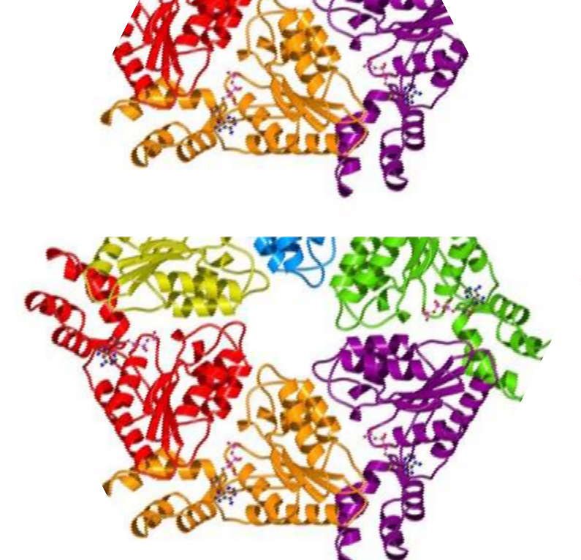
Docking can be between….
Protein - Ligand
Protein – Protein
Protein – Nucleotide

Slide 9
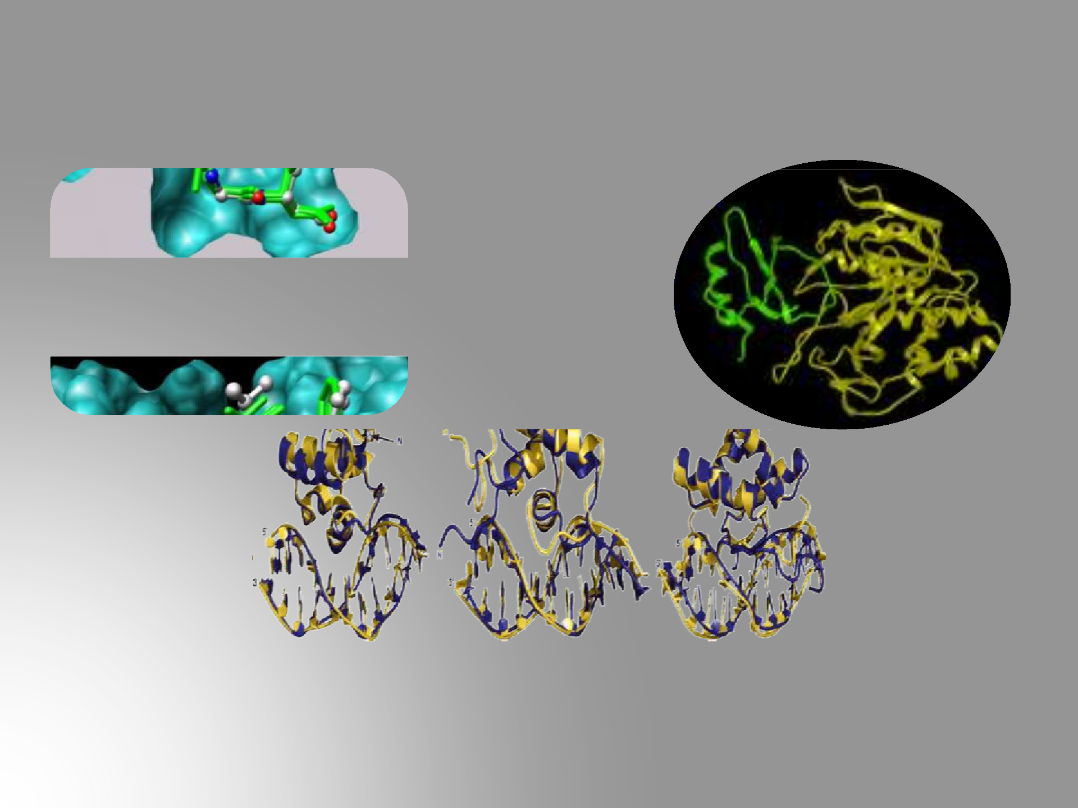
Protein - Protein
Protein - Ligand
Protein - Nucleotide

Slide 10
TYPES OF INTERACTIONS
Electrostatic forces - Forces with electrostatic origin are due to the charges
residing in the matter.
Electrodynamics forces - The most widely known is probably the van der Waals
interaction.
Steric forces - These are caused by entropy. For example, in cases where entropy is limited, there may be forces to minimize the free energy of the system.
Solvent-related forces – These are due to the structural changes of the solvent. These structural changes are generated, when ions, colloids, proteins etc, are added into the structure of solvent. The most commonly are Hydrogen bond and hydrophobic interactions

Slide 11
Key stages in docking
Target/Receptor selection and preparation
Ligand selection and preparation
Docking
Evaluating docking results

Slide 12




A typical docking workflow
TARGET SELECTION
LIGAND SELECTION
TARGET
PREPARATION
LIGAND PREPARATION
DOCKING
EVALUATING DOCKING RESULT

Slide 13
Receptor selection and preparation
Building the Receptor
The 3D structure of the receptor should be considered which can be downloaded from PDB.
The available structure should be processed.
The receptor should be biologically active and stable.
Identification of the Active Site
The active site within the receptor should be identified.
The receptor may have many active sites but the one of the interest should
be selected.

Slide 14
Ligand selection and preparation
Ligands can be obtained from various databases like ZINC, PubChem or can
be sketched using tools like Chemsketch.
Docking
The ligand is docked onto the receptor and the interactions are checked. The scoring function generates score, depending on which the best fit ligand is selected.

Slide 15
Softwares
SANJEEVINI – IIT Delhi (www.scfbio-iitd.res.in/sanjeevini/sanjeevini.jsp)
GOLD – University of Cambridge ,UK (www.ccdc.cam.ac.uk/Solutions/GoldSuite/Pages/GOLD.aspx)
AUTODOCK - Scripps Research Institute,USA (autodock.scripps.edu/)
GemDock(Generic Evolutionary Method for Molecular Docking) - A tool, developed by Jinn-Moon Yang, a professor of the Institute of Bioinformatics, National Chiao Tung University, Taiwan (gemdock.life.nctu.edu.tw/dock/)
Hex Protein Docking - University of Aberdeen, UK (hex.loria.fr/)
GRAMM (Global Range Molecular Matching) Protein docking - A Center for Bioinformatics, University of Kansas, USA (www.bioinformatics.ku.edu/files/vakser/gramm/)

Slide 16
Applications
Virtual screening (hit identification)
docking with a scoring function can be used to quickly screen large databases of potential drugs in silico to identify molecules that are likely to bind to protein target of interest.

Slide 17
Drug Discovery (lead optimization)
docking can be used to predict in where and in which relative orientation a ligand binds to a protein (binding mode or pose). This information may in turn be used to design more potent and selective analogs.
Bioremediation
Protein ligand docking can also be used to predict pollutants that can be degraded by enzymes.

Slide 18
REFERENCE
Morris GM, Goodsell DS, Halliday RS, Huey R, Hart WE, Belew RK, Olson AJ (1998). "Automated docking using a Lamarckian genetic algorithm and an empirical binding free energy function". Journal of Computational Chemistry 19 (14): 1639–1662.
Morris RJ, Najmanovich RJ, Kahraman A, Thornton JM (May 2005). "Real spherical harmonic expansion coefficients as 3D shape descriptors for protein binding pocket and ligand comparisons".Bioinformatics 21 (10): 2347–55.
Kahraman A, Morris RJ, Laskowski RA, Thornton JM (April 2007). "Shape variation in protein binding pockets and their ligands". J. Mol. Biol. 368 (1): 283–301.
Suresh PS, Kumar A, Kumar R, Singh VP (January 2008). "An in silico [correction of insilico] approach to bioremediation: laccase as a case study". J. Mol. Graph. Model. 26 (5): 845–9.
www.ncbi.nlm.nih.gov/pubmed/18446297

Slide 19
